Slide 1

Mapping the Autism Landscape
By Cody Safewright and Nicholas Rodgers

Slide 2

Agenda
Objective
Overview of our data
Look at the Original Data
Data cleaning
Graphs
Databricks jobs
Prometheus
Conclusion and questions

Slide 3
Our Objective
Find how Autism Spectrum Disorder (ASD) has grown globally
Build a data pipeline to help clean our dataset

Slide 4

Overview of our Data
Our ASD data comes from the Autism Prevalence Studies dataset from Center for Disease Control
Research conducted globally by local and national research including nationwide, state, and local research
Curated from 1962-2022
The data can be found here

Slide 5
How our data originally looked
26 column including:
  Author, Title, Year
  Country, Area(s)
  Age Range
  Study years
  Case Identification Method and Criteria
  Sample size, number of cases, ASD Prevalence per 1000
  Confidence Interval
  Races (White or Non-white)
  Diagnosis Age (range, median, mean) by months
  IQ score, adaptive score
  Non-verbal to minimally verbal (%)
  Classification, publication, and calculated values

Slide 6
That’s a lot but here’s the issue:
A majority of that data was empty or useless for analytics…

Slide 7
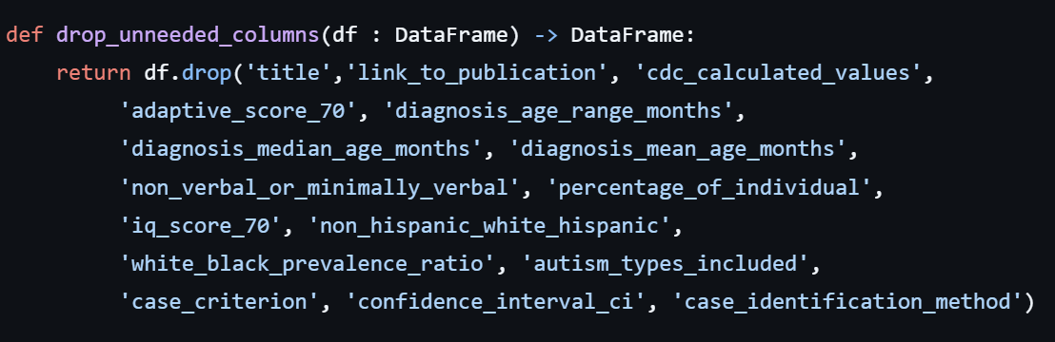
Data Cleaning: Removing Attributes
16 columns dropped

Slide 8
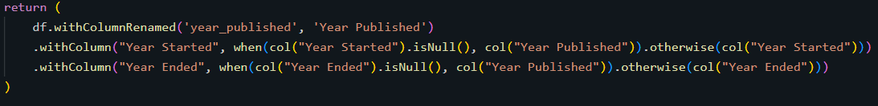
Data Cleaning: Missing Values
Male:Female Sex Ratio - averaged
Missing localites - ‘Unknown’
Age - averaged
Study Years [Year Started, Year Ended] - Year Published
Dropped rows missing ‘Sample Size’ or ‘Number of Cases’

Slide 9
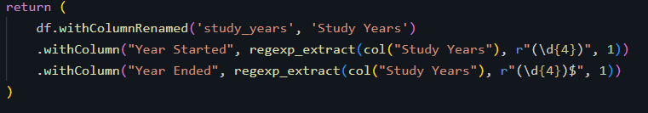
Data Cleaning: Data Enrichment
Age Range - [0-12] ->
  Youngest Age - [0]
  Oldest Age - [12]
Study Years - [2010-2012] ->
  Year Started - [2010]
  Year Ended - [2012]

Slide 10
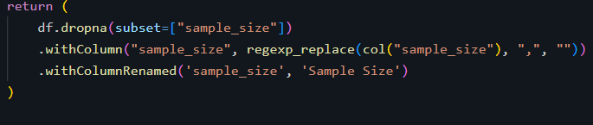
Data Cleaning: Data Type Format
Sample Size - [3,012,321] -> [3012321]
Number of Cases - [23,014] -> [23014]

Slide 11
Our Dataset After Cleaning
Now the data we have includes only 10 columns:
Author
Year Published
Country
Area(s)
Sample Size
ASD Prevalence Estimate per 1,000
Male:Female Sex Ratio
Year Started
Year Ended
Youngest Age
Oldest Age

Slide 12
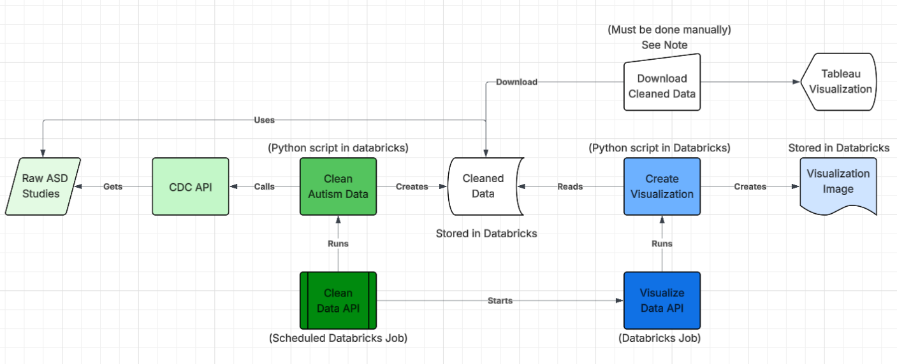
Data pipeline

Slide 13
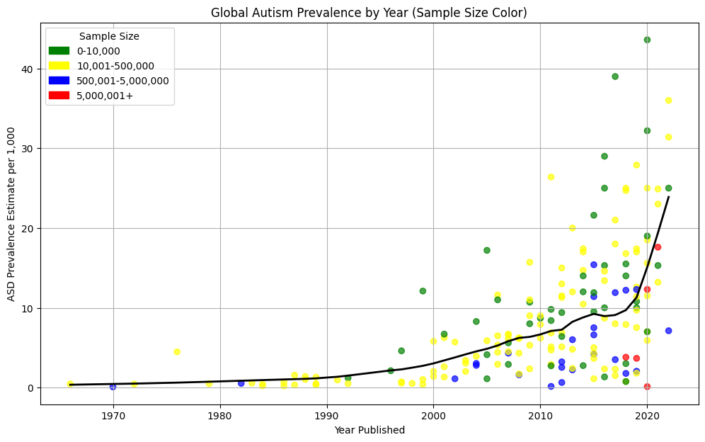

Slide 14
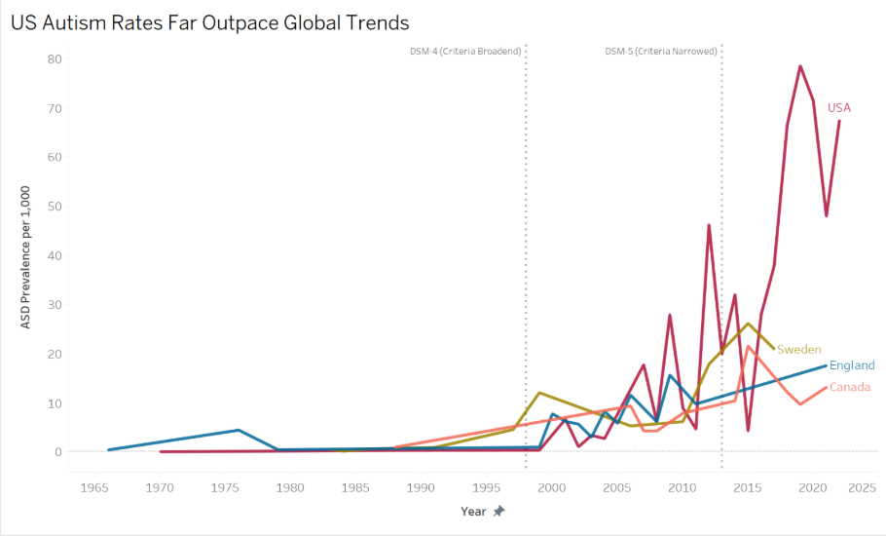

Slide 15
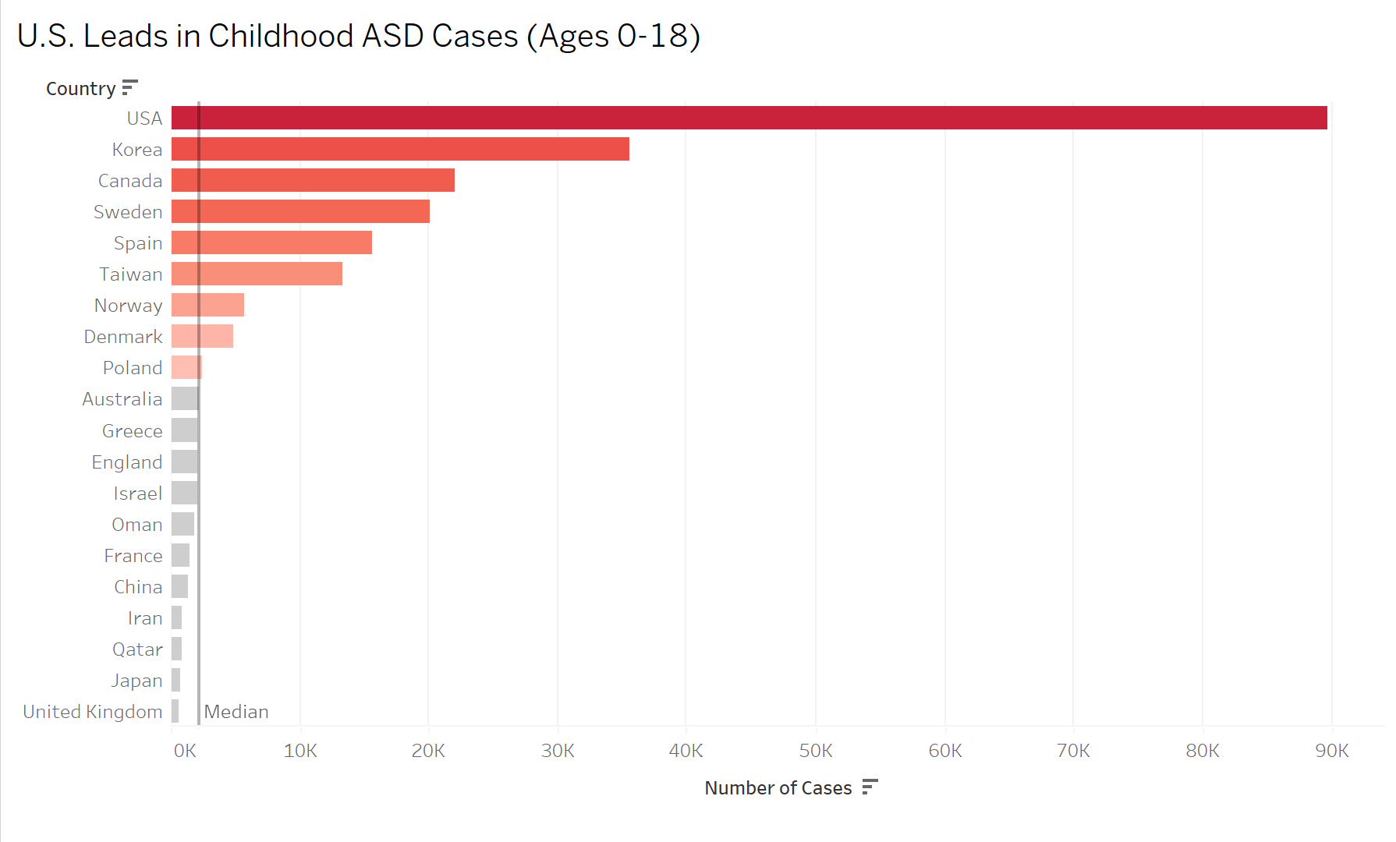

Slide 16
Databricks Jobs
Simple UI
Metrics
History
Tasks
Schedules/Triggers

Slide 17
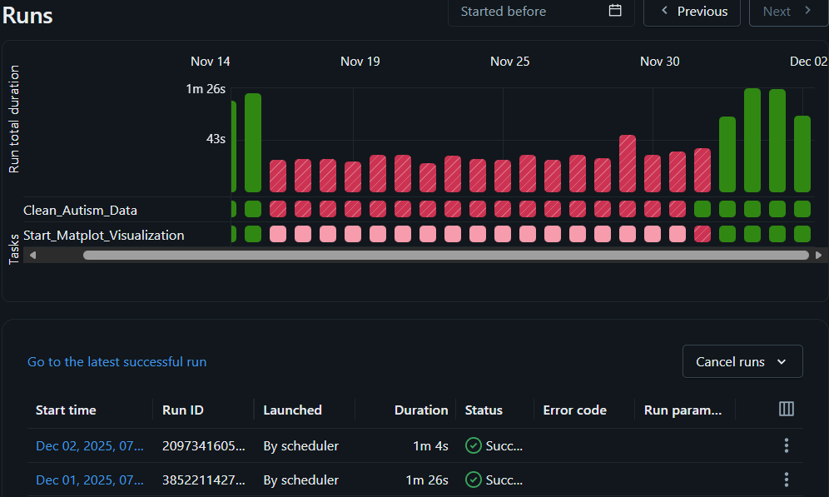

Slide 18
Prometheus
Metrics monitoring
Rules/Alerts
Queries

Slide 19
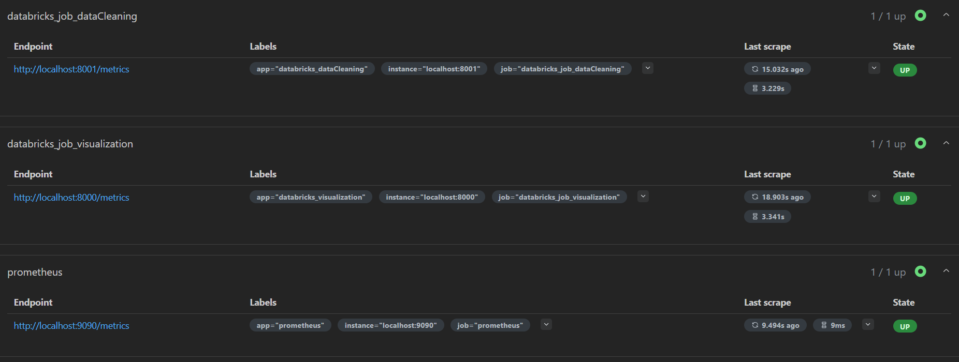

Slide 20
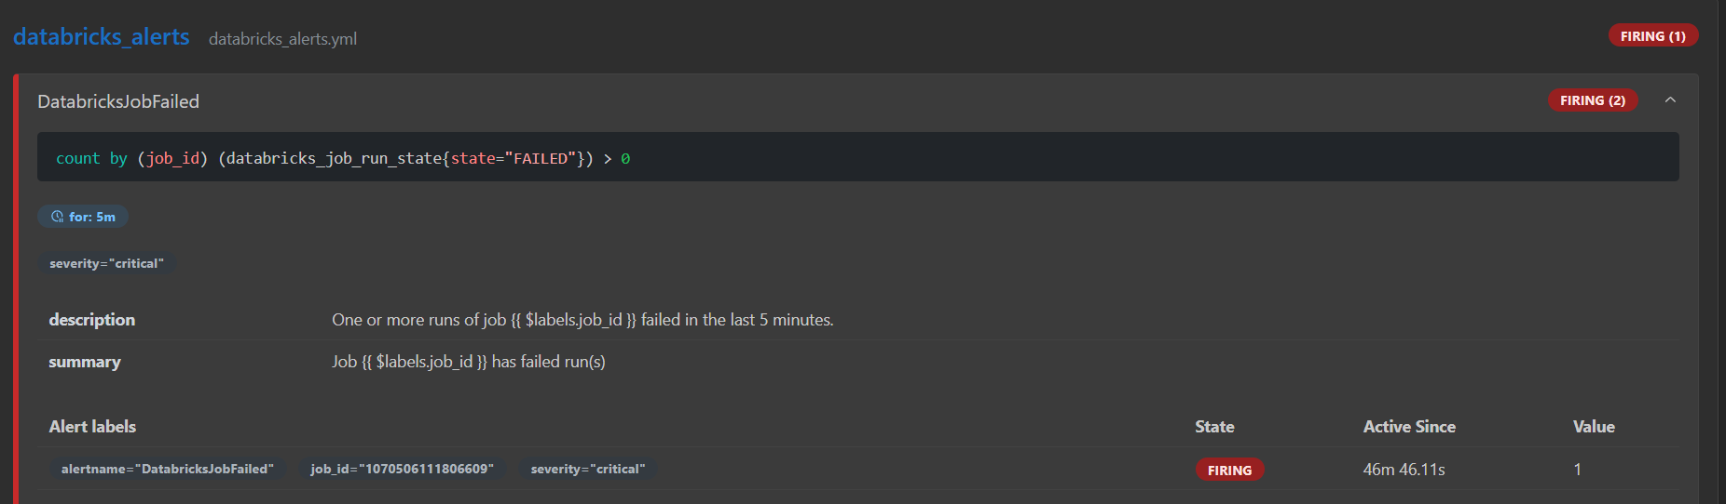
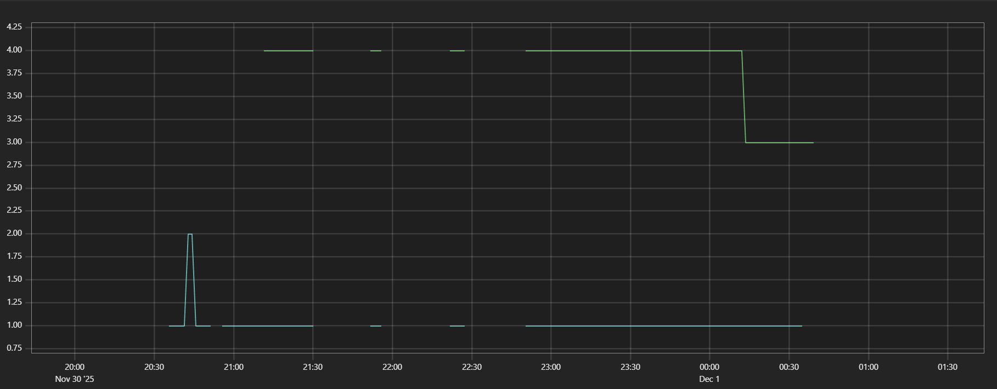

Slide 21
Conclusion
What’d we learn from the data?
Autism in the US is the fastest growing
Autism rates have gone up globally
What we learned for the project
Using good data makes a better project
Getting code to work together can be a pain

Slide 22

Any Questions???

